Slide 1
Inheritance

Slide 2
Inheritance
Suppose you define classes to model circles, rectangles, and triangles. These classes have many common features. What is the best way to design these classes so to avoid redundancy? The answer is to use inheritance.

Slide 3
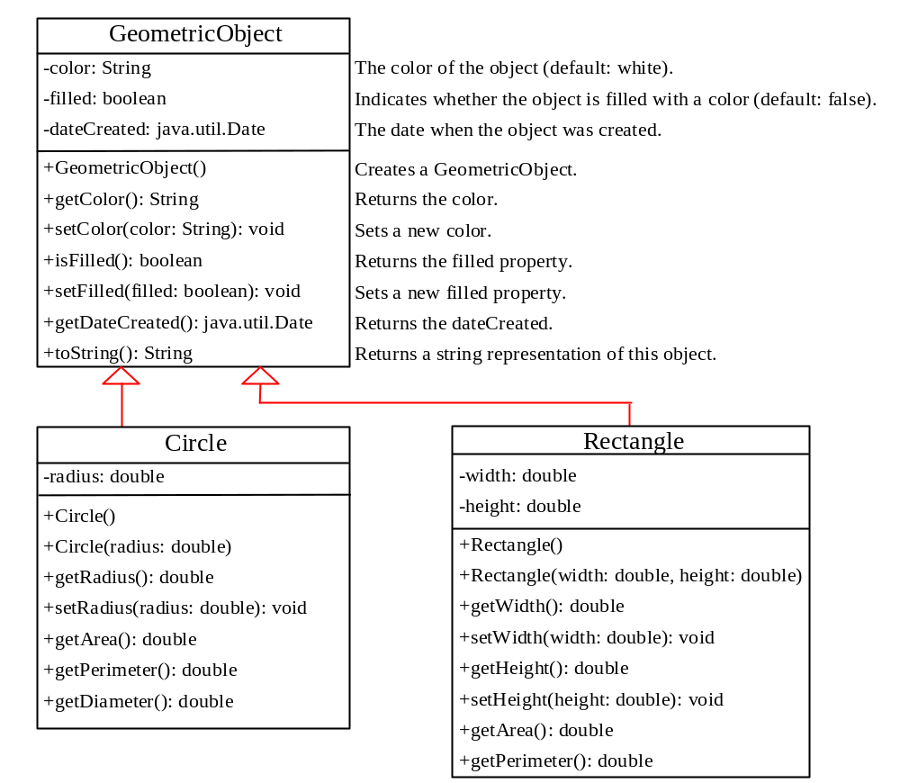
Superclasses and Subclasses

Slide 4
Are Superclass’s Constructor Inherited?
No. They are not inherited.
They are invoked explicitly or implicitly.
Explicitly using the super keyword.
A superclass's constructors can only be invoked from the subclasses' constructors, using the keyword super.
If the keyword super is not explicitly used, the superclass's no-arg constructor is automatically invoked.

Slide 5


Superclass’s Constructor Is Always Invoked
A constructor may invoke an overloaded constructor or its superclass’s constructor. If none of them is invoked explicitly, the compiler puts super() as the first statement in the constructor. For example,

Slide 6
Using the Keyword super
The keyword super refers to the superclass of the class in which super appears. This keyword can be used in two ways:
To call a superclass constructor
To call a superclass method

Slide 7
CAUTION
You must use the keyword super to call the superclass constructor.
Invoking a superclass constructor’s name in a subclass causes a syntax error.
Java requires that the statement that uses the keyword super appear first in the constructor.

Slide 8
Constructor Chaining
Constructing an instance of a class invokes all the superclasses’ constructors along the inheritance chain. This is called constructor chaining.
public class Faculty extends Employee {
public static void main(String[] args) {
new Faculty();
}
public Faculty() {
System.out.println("(4) Faculty's no-arg constructor is invoked");
}
}
class Employee extends Person {
public Employee() {
this("(2) Invoke Employee’s overloaded constructor");
System.out.println("(3) Employee's no-arg constructor is invoked");
}
public Employee(String s) {
System.out.println(s);
}
}
class Person {
public Person() {
System.out.println("(1) Person's no-arg constructor is invoked");
}
}

Slide 9
Trace Execution
public class Faculty extends Employee {
public static void main(String[] args) {
new Faculty();
}
public Faculty() {
System.out.println("(4) Faculty's no-arg constructor is invoked");
}
}
class Employee extends Person {
public Employee() {
this("(2) Invoke Employee’s overloaded constructor");
System.out.println("(3) Employee's no-arg constructor is invoked");
}
public Employee(String s) {
System.out.println(s);
}
}
class Person {
public Person() {
System.out.println("(1) Person's no-arg constructor is invoked");
}
}
1. Start from the main method

Slide 10
Trace Execution
public class Faculty extends Employee {
public static void main(String[] args) {
new Faculty();
}
public Faculty() {
System.out.println("(4) Faculty's no-arg constructor is invoked");
}
}
class Employee extends Person {
public Employee() {
this("(2) Invoke Employee’s overloaded constructor");
System.out.println("(3) Employee's no-arg constructor is invoked");
}
public Employee(String s) {
System.out.println(s);
}
}
class Person {
public Person() {
System.out.println("(1) Person's no-arg constructor is invoked");
}
}
2. Invoke Faculty constructor

Slide 11
Trace Execution
public class Faculty extends Employee {
public static void main(String[] args) {
new Faculty();
}
public Faculty() {
System.out.println("(4) Faculty's no-arg constructor is invoked");
}
}
class Employee extends Person {
public Employee() {
this("(2) Invoke Employee’s overloaded constructor");
System.out.println("(3) Employee's no-arg constructor is invoked");
}
public Employee(String s) {
System.out.println(s);
}
}
class Person {
public Person() {
System.out.println("(1) Person's no-arg constructor is invoked");
}
}
3. Invoke Employee’s no-arg constructor

Slide 12
Trace Execution
public class Faculty extends Employee {
public static void main(String[] args) {
new Faculty();
}
public Faculty() {
System.out.println("(4) Faculty's no-arg constructor is invoked");
}
}
class Employee extends Person {
public Employee() {
this("(2) Invoke Employee’s overloaded constructor");
System.out.println("(3) Employee's no-arg constructor is invoked");
}
public Employee(String s) {
System.out.println(s);
}
}
class Person {
public Person() {
System.out.println("(1) Person's no-arg constructor is invoked");
}
}
4. Invoke Employee(String) constructor

Slide 13
Trace Execution
public class Faculty extends Employee {
public static void main(String[] args) {
new Faculty();
}
public Faculty() {
System.out.println("(4) Faculty's no-arg constructor is invoked");
}
}
class Employee extends Person {
public Employee() {
this("(2) Invoke Employee’s overloaded constructor");
System.out.println("(3) Employee's no-arg constructor is invoked");
}
public Employee(String s) {
System.out.println(s);
}
}
class Person {
public Person() {
System.out.println("(1) Person's no-arg constructor is invoked");
}
}
5. Invoke Person() constructor

Slide 14
Trace Execution
public class Faculty extends Employee {
public static void main(String[] args) {
new Faculty();
}
public Faculty() {
System.out.println("(4) Faculty's no-arg constructor is invoked");
}
}
class Employee extends Person {
public Employee() {
this("(2) Invoke Employee’s overloaded constructor");
System.out.println("(3) Employee's no-arg constructor is invoked");
}
public Employee(String s) {
System.out.println(s);
}
}
class Person {
public Person() {
System.out.println("(1) Person's no-arg constructor is invoked");
}
}
6. Execute println

Slide 15
Trace Execution
public class Faculty extends Employee {
public static void main(String[] args) {
new Faculty();
}
public Faculty() {
System.out.println("(4) Faculty's no-arg constructor is invoked");
}
}
class Employee extends Person {
public Employee() {
this("(2) Invoke Employee’s overloaded constructor");
System.out.println("(3) Employee's no-arg constructor is invoked");
}
public Employee(String s) {
System.out.println(s);
}
}
class Person {
public Person() {
System.out.println("(1) Person's no-arg constructor is invoked");
}
}
7. Execute println

Slide 16
Trace Execution
public class Faculty extends Employee {
public static void main(String[] args) {
new Faculty();
}
public Faculty() {
System.out.println("(4) Faculty's no-arg constructor is invoked");
}
}
class Employee extends Person {
public Employee() {
this("(2) Invoke Employee’s overloaded constructor");
System.out.println("(3) Employee's no-arg constructor is invoked");
}
public Employee(String s) {
System.out.println(s);
}
}
class Person {
public Person() {
System.out.println("(1) Person's no-arg constructor is invoked");
}
}
8. Execute println

Slide 17
Trace Execution
public class Faculty extends Employee {
public static void main(String[] args) {
new Faculty();
}
public Faculty() {
System.out.println("(4) Faculty's no-arg constructor is invoked");
}
}
class Employee extends Person {
public Employee() {
this("(2) Invoke Employee’s overloaded constructor");
System.out.println("(3) Employee's no-arg constructor is invoked");
}
public Employee(String s) {
System.out.println(s);
}
}
class Person {
public Person() {
System.out.println("(1) Person's no-arg constructor is invoked");
}
}
9. Execute println

Slide 18
Example on the Impact of a Superclass without no-arg Constructor
Find out the errors in the program:
public class Apple extends Fruit {
}
class Fruit {
public Fruit(String name) {
System.out.println("Fruit's constructor is invoked");
}
}

Slide 19
Declaring a Subclass
A subclass extends properties and methods from the superclass. You can also:
  Add new properties
  Add new methods
  Override the methods of the superclass

Slide 20
Calling Superclass Methods
You could rewrite the printCircle() method in the Circle class as follows:
public void printCircle() {
System.out.println("The circle is created " +
super.getDateCreated() + " and the radius is " + radius);
}

Slide 21
Overriding Methods in the Superclass
A subclass inherits methods from a superclass. Sometimes it is necessary for the subclass to modify the implementation of a method defined in the superclass. This is referred to as method overriding.
public class Circle extends GeometricObject {
// Other methods are omitted
/** Override the toString method defined in GeometricObject */
public String toString() {
return super.toString() + "\nradius is " + radius;
}
}

Slide 22
NOTE
An instance method can be overridden only if it is accessible. Thus a private method cannot be overridden, because it is not accessible outside its own class. If a method defined in a subclass is private in its superclass, the two methods are completely unrelated.

Slide 23
NOTE
Like an instance method, a static method can be inherited. However, a static method cannot be overridden. If a static method defined in the superclass is redefined in a subclass, the method defined in the superclass is hidden.

Slide 24
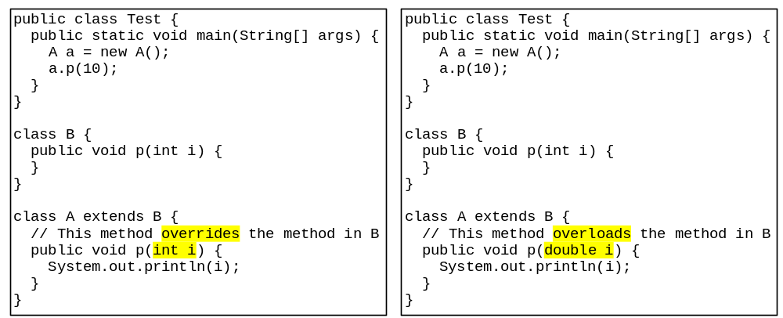
Overriding vs. Overloading

Slide 25

The Object Class and Its Methods
Every class in Java is descended from the java.lang.Object class. If no inheritance is specified when a class is defined, the superclass of the class is Object.

Slide 26
The toString() method in Object
The toString() method returns a string representation of the object. The default implementation returns a string consisting of a class name of which the object is an instance, the at sign (@), and a number representing this object.
Loan loan = new Loan();
System.out.println(loan.toString());
The code displays something like Loan@15037e5 . This message is not very helpful or informative. Usually you should override the toString method so that it returns a digestible string representation of the object.

Slide 27
Immutable Objects and Classes
If the contents of an object cannot be changed once the object is created, the object is called an immutable object and its class is called an immutable class.
If you delete the set method in the Circle class in the preceding example, the class would be immutable because radius is private and cannot be changed without a set method.
A class with all private data fields and without mutators is not necessarily immutable. For example, the following class Student has all private data fields and no mutators, but it is mutable.

Slide 28
Example
public class BirthDate {
private int year;
private int month;
private int day;
public BirthDate(int newYear,
int newMonth, int newDay) {
year = newYear;
month = newMonth;
day = newDay;
}
public void setYear(int newYear) {
year = newYear;
}
}
public class Student {
private int id;
private BirthDate birthDate;
public Student(int ssn,
int year, int month, int day) {
id = ssn;
birthDate = new BirthDate(year, month, day);
}
public int getId() {
return id;
}
public BirthDate getBirthDate() {
return birthDate;
}
}
public class Test {
public static void main(String[] args) {
Student student = new Student(111223333, 1970, 5, 3);
BirthDate date = student.getBirthDate();
date.setYear(2010); // Now the student birth year is changed!
}
}

Slide 29
What Class is Immutable?
For a class to be immutable:
- it must mark all data fields private, and
- provide no mutator methods, and
- provide no accessor methods that would return a reference to a mutable data field object.

Slide 30
Scope of Variables
The scope of instance and static variables is the entire class. They can be declared anywhere inside a class.
The scope of a local variable starts from its declaration and continues to the end of the block that contains the variable. A local variable must be initialized explicitly before it can be used.

Slide 31
this Keyword
The this keyword is the name of a reference that refers to an object itself. One common use of the this keyword is reference a class’s hidden data fields.
Another common use of the this keyword to enable a constructor to invoke another constructor of the same class.

Slide 32
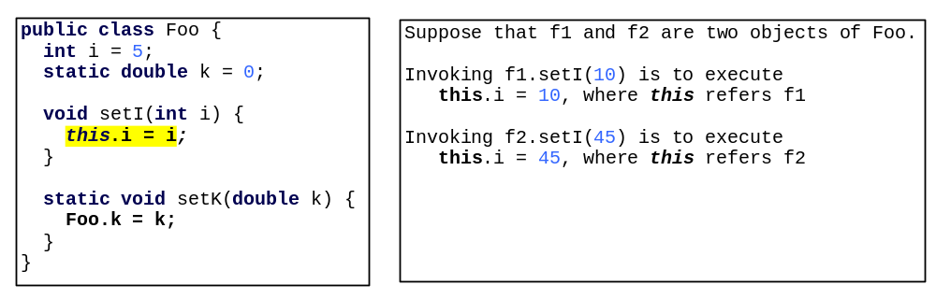
Reference the Hidden Data Fields

Slide 33

Calling Overloaded Constructor

Slide 34

Class Abstraction and Encapsulation
Class abstraction means to separate class implementation from the use of the class. The creator of the class provides a description of the class and let the user know how the class can be used. The user of the class does not need to know how the class is implemented. The detail of implementation is encapsulated and hidden from the user.

Slide 35
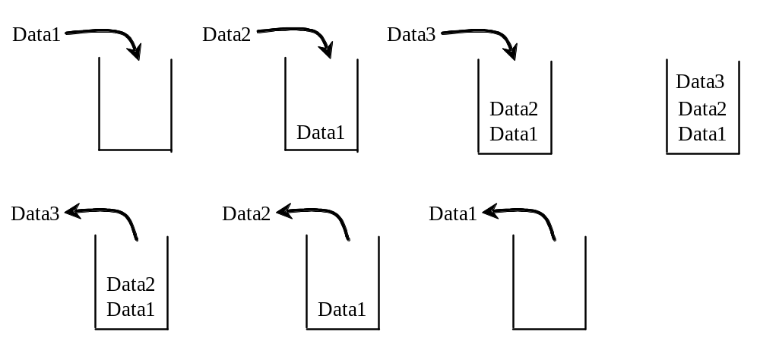
Designing the StackOfIntegers Class

Slide 36
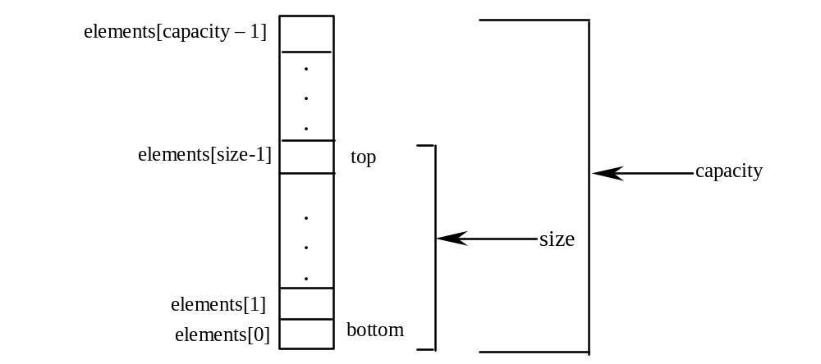
Implementing StackOfIntegers Class

Slide 37

Example: StackOfIntegers Class

